Slide 1
MVC – CodeIgniter
DR. dIAZ

Slide 2
Agenda
What is MVC?
What is CodeIgniter?
How is its architecture?

Slide 3
MVC
It is a design software pattern dealing with SOC( Separation of Concern)
It is about using DRY ( Do not repeat yourself)
It is about organizing your code in a way concerns are separated and yet interact with each one.
Your application SPLIT in 3 folders: Controller, View, Model.
URL: http://www.codeigniter.com/user_guide/

Slide 4
CodeIgniter
What is it?
Installation?
Directory Structure

Slide 5
What is it?
CodeIgniter is a powerful PHP framework with a very small footprint, built for developers who need a simple and elegant toolkit to create full-featured web applications. CodeIgniter was created by EllisLab, and is now a project of the British Columbia Institute of Technology.

Slide 6
CodeIgniter
CodeIgniter is an application development framework, which can be used to develop websites, using PHP. It is an Open Source framework. It has a very rich set of functionality, which will increase the speed of website development work.
CodeIgniter Features
Model-View-Controller Based System
Extremely Light Weight
Full Featured database classes with support for several platforms.
Query Builder Database Support
Form and Data Validation
Security and XSS Filtering
Session Management
Email Sending Class. Supports Attachments, HTML/Text email, multiple protocols (sendmail, SMTP, and Mail) and more.
Image Manipulation Library (cropping, resizing, rotating, etc.). Supports GD, ImageMagick, and NetPBM
File Uploading Class
FTP Class
Localization
Pagination
Data Encryption
Benchmarking
Full Page Caching
Error Logging
Application Profiling
Calendaring Class

Slide 7
User Agent Class
Zip Encoding Class
Template Engine Class
Trackback Class
XML-RPC Library
Unit Testing Class
Search-engine Friendly URLs
Flexible URI Routing
Support for Hooks and Class Extensions
Large library of “helper” functions

Slide 8
Installation
Step-1 − Download the CodeIgniter from the link CodeIgniter
There are two different options legacy and latest. The names itself are self descriptive. legacy has version less than 2.x and latest has 3.0 version.
We can also go with GitHub and get all of the latest scripts..
Step-2 − Unzip the folder.
Step-3 − Upload all files and folders to your server.
Step-4 − After uploading all the files to your server, visit the URL of your server, e.g., www.domain-name.com.

Slide 9
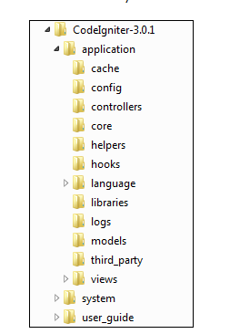
Directory Structure
CodeIgniter directory structure is divided into 3 folders −
Application
System
User_guide

Slide 10
Tutorial
http://www.codeigniter.com/user_guide/tutorial/index.html
Look at localhost/ci

Slide 11
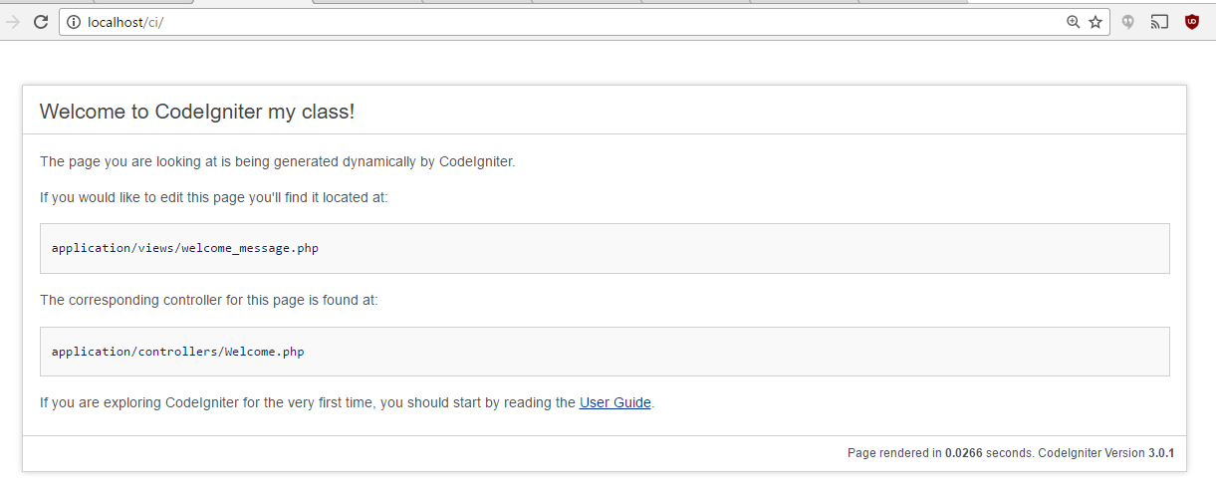

Slide 12
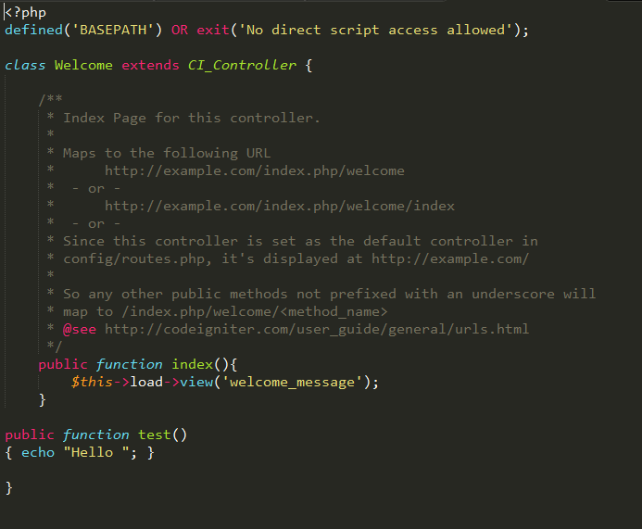

Slide 13
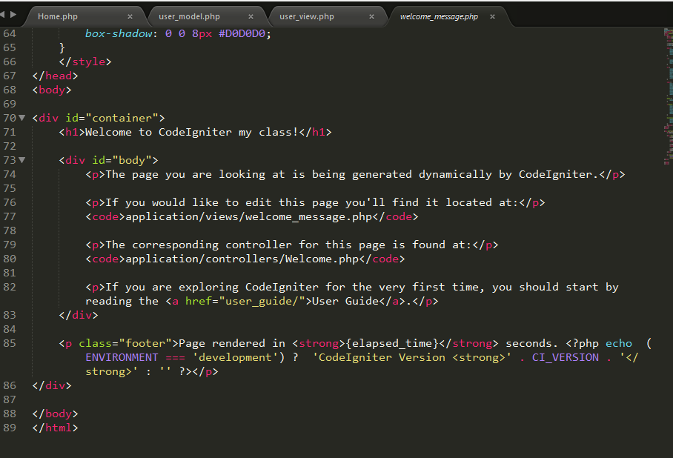

Slide 14
Create a Controller & a View
1. <?php
Class Home extends CI_Controller {
Public function index(){
$this->load->view(‘home_view’);
}
}
2. Save this as Home in the controller folder
1. <?php
4. save it as home_view in the View folder

Slide 15
Create a Model
Make sure that you have a Database to connect it to your model
1. My database is wdm, it has one table users with 3 fields id, username,password.
2. <?php
Class User_model extends CI_MODEL { }
3. Save this a user_model in the model folder
4. We have an empty Model

Slide 16
Connect your Model and the Controller
1. //connect your model with the db
// go to config.php
// go to database.php
Update $db['default'] = array(
'dsn' => '',
'hostname' => 'localhost',
'username' => 'root',
'password' => '',
'database' => 'wdm',
'dbdriver' => 'mysqli',
'dbprefix' => '',
'pconnect' => FALSE,
'db_debug' => (ENVIRONMENT !== 'production'),
'cache_on' => FALSE,
'cachedir' => '',
'char_set' => 'utf8',
'dbcollat' => 'utf8_general_ci',
'swap_pre' => '',
'encrypt' => FALSE,
'compress' => FALSE,
'stricton' => FALSE,
'failover' => array(),
'save_queries' => TRUE
go to autoload.php $autoload['libraries'] = array('database’); autoload.php{‘model’) = array(‘user_model’) Go to model,
2. go to user_model Class User_model extends CI_Model { $this->db->get(‘users’)
Return $query._>$result();
}

Slide 17
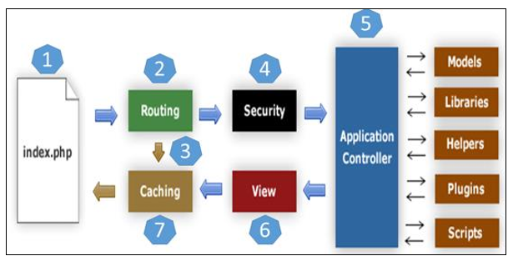
Architecture
1. First go to index.php page.
2. Routing will decide whether to pass this request to step-3 for caching or to pass this request to step-4 for security check.
If the requested page is already in Caching, then Routing will pass the request to step-3 and the response will go back to the user.
If the requested page does not exist in Caching, then Routing will pass the requested page to step-4 for Security checks.
Before passing the request to Application Controller, the Security of the submitted data is checked. After the Security check, the Application Controller loads necessary Models, Libraries, Helpers, Plugins and Scripts and pass it on to View.
The View will render the page with available data and pass it on for Caching. As the requested page was not cached before so this time it will be cached in Caching, to process this page quickly for future requests.

Slide 18
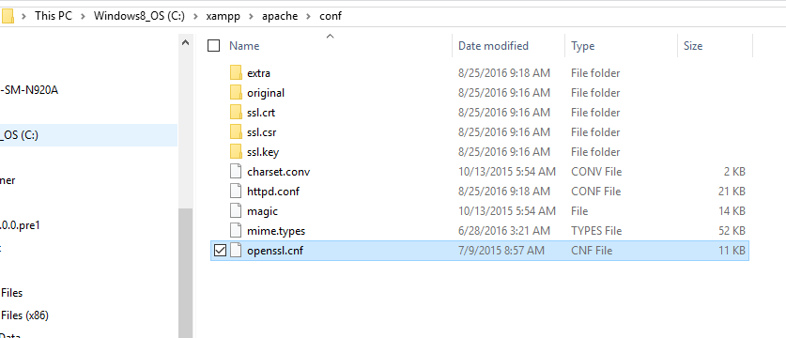
How to remove the index.php from the address bar
Step 1: Enable Mod Rewrite Option in your APACHE Server
Goto apache's "httpd.conf" file and search for the line,
LoadModule rewrite_module modules/mod_rewrite.so
If the above line is preceded with # (in which case, the module is disabled), then remove the # (hash) symbol to enable url rewriting.
Step 2: Create '.htaccess' File
Create the .htaccess file at the root directory.
Save it as ".htaccess" (make sure you type the filename within quotes to avoid the file to be saved as text file) in the root directory.

Slide 19
How to remove the index.php from the address bar Step 2
<IfModule mod_rewrite.c>
RewriteEngine On RewriteBase /
RewriteCond %{THE_REQUEST} ^GET.*index\.php [NC]
RewriteCond %{REQUEST_URI} !/system/.* [NC]
RewriteRule (.*?)index\.php/*(.*) /$1$2 [R=301,NE,L]
RewriteCond %{REQUEST_FILENAME} !-f
RewriteCond %{REQUEST_FILENAME} !-d
RewriteRule ^(.*)$ index.php/$1 [L]
</IfModule>

Slide 20
How to remove the index.php from the address bar Step 3
Modify CodeIgniter Config Settings
Open config.php ,
Look for $config['index_page'] = 'index.php';
Remove index.php, i.e, $config['index_page'] = '';
Restart apache .
If it does not work
Find $config['uri_protocol'] ='AUTO' setting in config file and replace with $config['uri_protocol'] = 'REQUEST_URI'.
Reference:
http://www.kodingmadesimple.com/2014/12/codeigniter-remove-index.php-from-url.html

Slide 21
CRUD ( Create, Retrieve, Update and Delete)
Helper functions
How to Insert
How to Update
Session
What is a Session
How to start a session
How to save Data
How to retrieve data

Slide 22
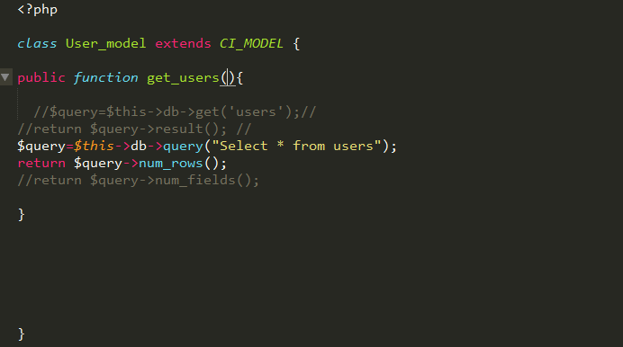
CRUD ( Create, Retrieve, Update and Delete)
Helper functions
in the user model, we have:
$query=$this->db->get(‘users’);
Return $query->results(); Helper functions
Can have $query=$this->db->query(“select * from users’);
Return $query->num_rows();
In views: echo $results;

Slide 23
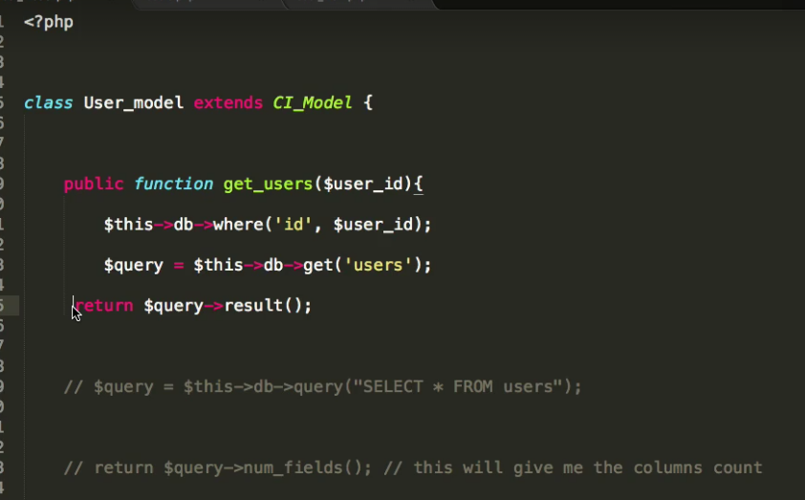
CRUD ( Create, Retrieve, Update and Delete)/ Select based on a condition
Go to user_model:
Comment out all lines related to getting everything from the users table.
Add this line $this->db->where(‘id’,$userid);
Modify the get_users() to pass $userid
$query=Sthis->db->get(‘users’);
Return $query->result();
Go to Controller
We have get_user(1)
Or on the localhost/controller/method/parameter

Slide 24
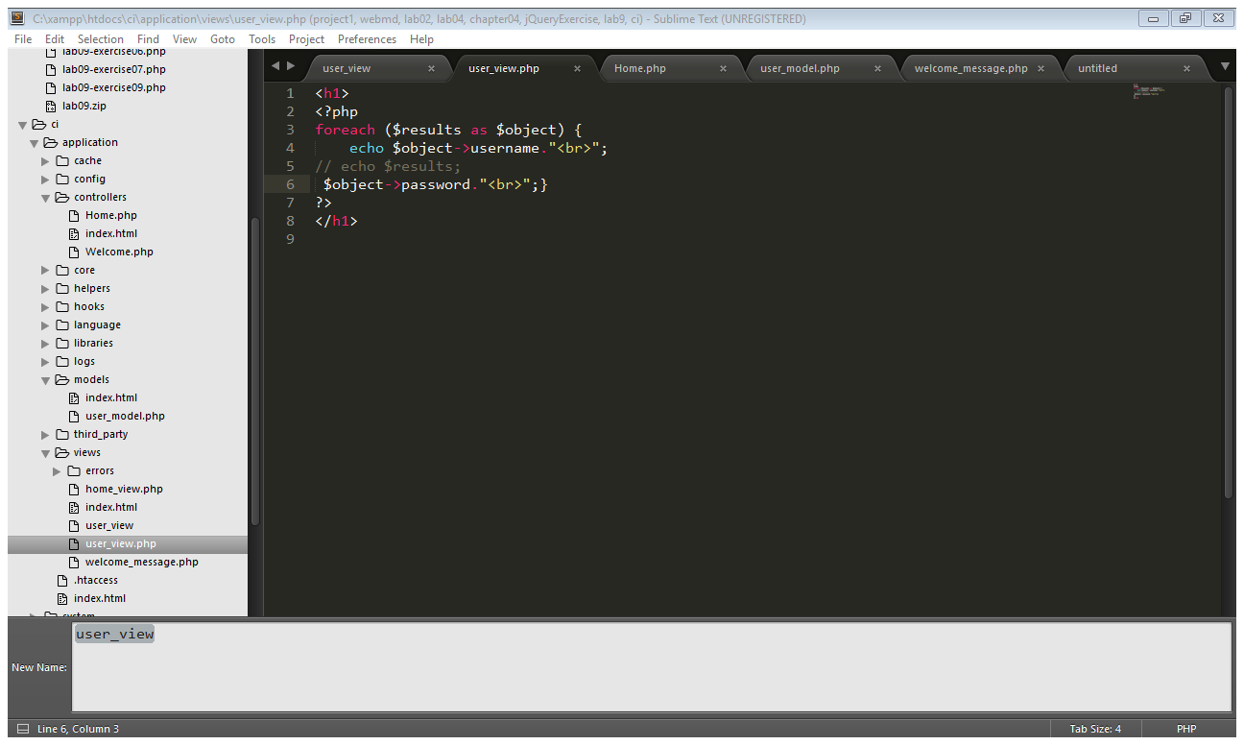
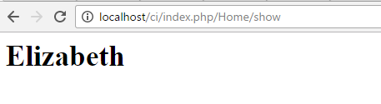
CRUD ( Create, Retrieve, Update and Delete)/ Select based on a condition
Go to views >user_view:

Slide 25
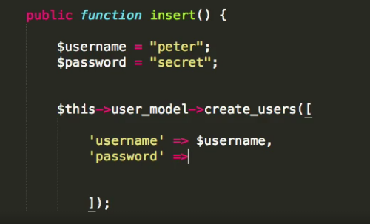
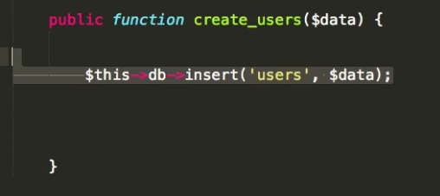
CRUD ( Create, Retrieve, Update and Delete) How to Insert
In the controller
Need a function insert()
Public function insert(){
$this->user_model->create_user([‘username’-”Elizabeth”,’password’=“Secret”]);}
In the model need a function create_users in the model,
Public function create_users()
{ $this->db->insert(‘users’,$data);}

Slide 26
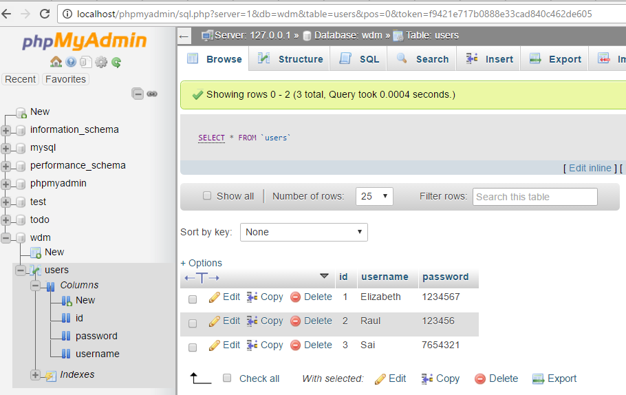
CRUD ( Create, Retrieve, Update and Delete) How to Insert

Slide 27
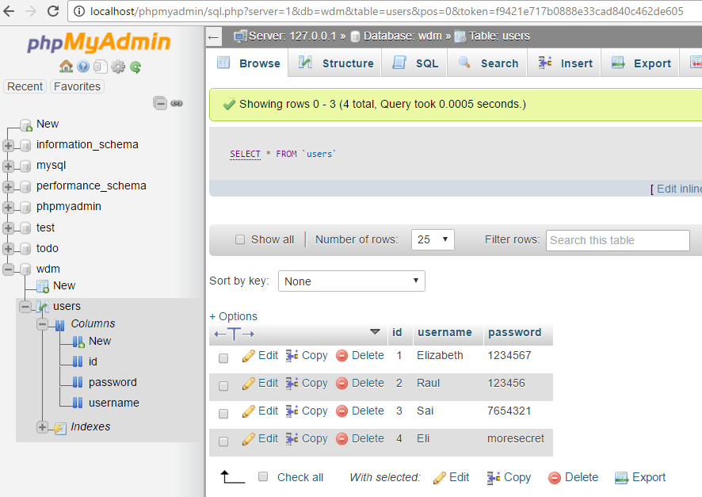
CRUD ( Create, Retrieve, Update and Delete) How to Insert

Slide 28
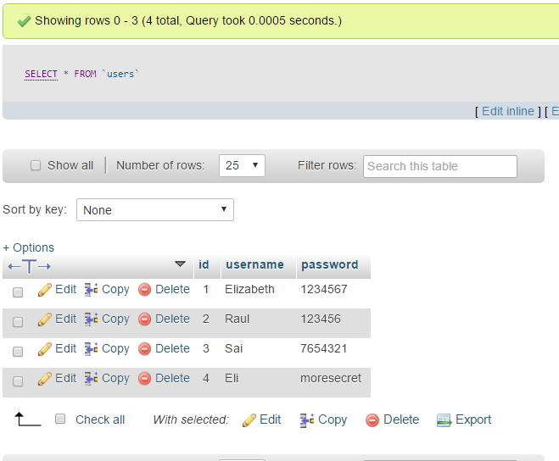
CRUD ( Create, Retrieve, Update and Delete) How to udpate

Slide 29
CRUD ( Create, Retrieve, Update and Delete) How to udpate
In the controller
Need a function update()
Public function update(){
$id=2;
$this->user_model->update_user([‘username’ ->, ”zabetha”,’password’=>“notSecret”]);}
In the model need a function update_users in the model,
Public function update_users(Sdata,$id)
{ $this->db->where([‘id’->$id]);
$this->db->update(‘users’,$data);}

Slide 30
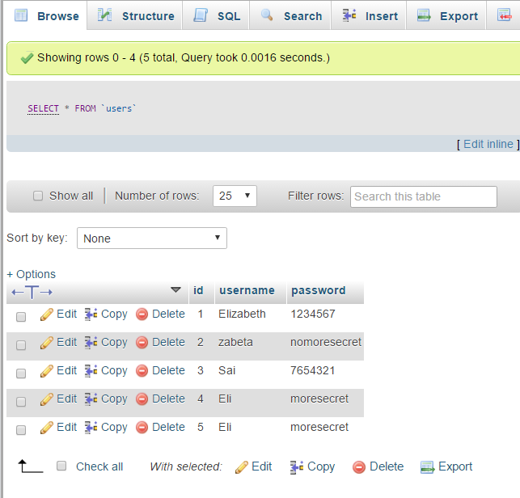
CRUD ( Create, Retrieve, Update and Delete) How to udpate
do localhost/index.php/Home/update

Slide 31
CRUD ( Create, Retrieve, Update and Delete)
What is a Session
Session support in PHP consists of a way to preserve certain data across subsequent accesses. This enables you to build more customized applications and increase the appeal of your web site.
How to start a session
<?php session_start();
How to save Data
Example #1 Registering a variable with $_SESSION.
<?php session_start(); if (!isset($_SESSION['count'])) { $_SESSION['count'] = 0; } else { $_SESSION['count']++; } ?>

Slide 32
Session Example
<?php session_start();
if( isset( $_SESSION['counter'] ) ) { $_SESSION['counter'] += 1; }
else { $_SESSION['counter'] = 1; }
$msg = "You have visited this page ". $_SESSION['counter'];
$msg .= "in this session."; ?>
<html
<head>
<title>Setting up a PHP session</title>
</head> <body>
<?php echo ( $msg ); ?>
</body>
</html>

